Slide 1
Meta Learning (Part 1)
Hung-yi Lee
Notes:
Any progress in architecture search
KeLi’s blog is good: https://bair.berkeley.edu/blog/2017/09/12/learning-to-optimize-with-rl/
\theta \phi 應該要用不同的顏色
Agnostic不可知論的
Very good tutorial !!!!!
Good summarization: https://lilianweng.github.io/lil-log/2018/11/30/meta-learning.html

Slide 2
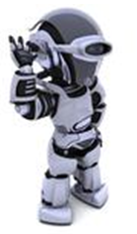
Introduction
Task 1: speech recognition
Task 2: image recognition
…
Task 100: text classification
Meta learning = Learn to learn
I can learn task 101 better because I learn some learning skills
Learning
task 1
Learning
task 2
Be a better learner
……
Life-long: one model for all the tasks
Learning
task 100
Meta: How to learn a new model
Notes:
we need our agents to learn how to learn new tasks faster by reusing previous experience
Model pre-training is also one approach of meta learning.
Very different from model pre-training

Slide 3
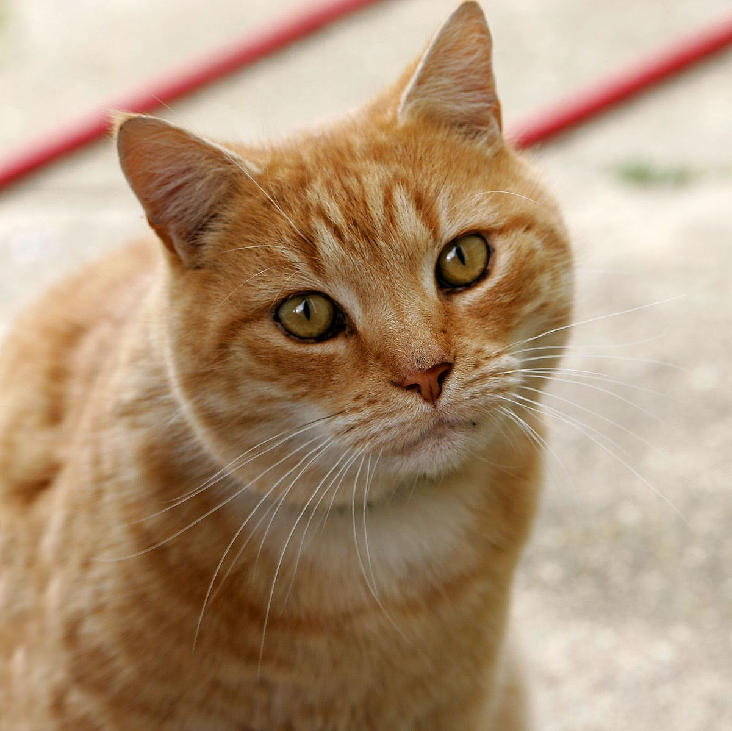
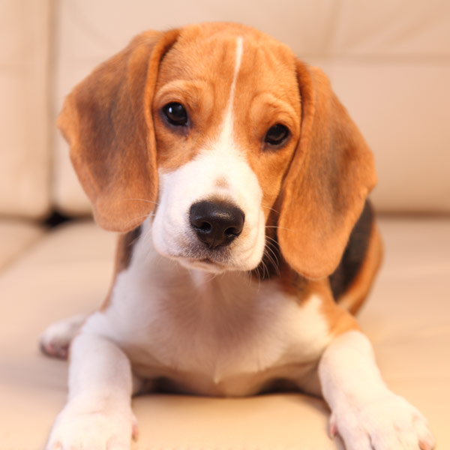

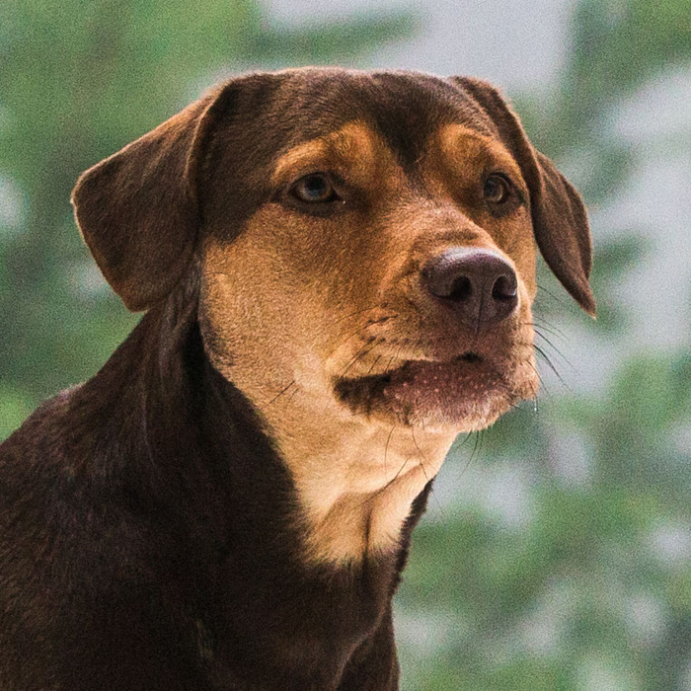



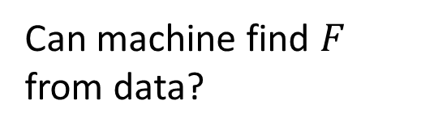


Meta Learning
$$f^{∗}=F\left(D_{train} \right)$$
Can machine find $F$ from data?
Designed by Developers
cat
It is also a function.
Learning
Algorithm
$$f^{∗}$$
$$F$$
cat
dog
cat
dog
Training Data
Testing Data
$$D_{train}$$

Slide 4

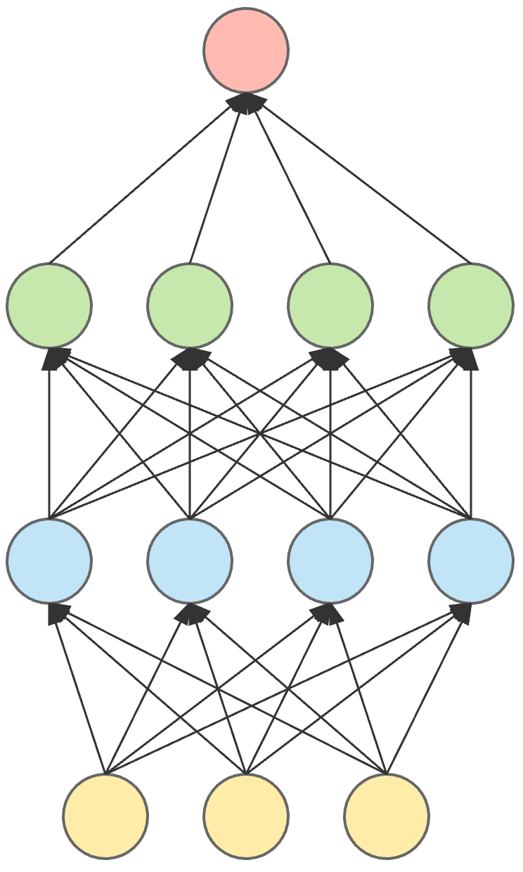



Meta Learning
Machine Learning
≈ 根據資料找一個函數 f 的能力
$$f\left( \right)=$$
“Cat”
Meta Learning
≈ 根據資料找一個找一個函數 f 的函數 F 的能力
$$F\left( \right)$$
$${=f}^{∗}$$
cat
dog
cat
dog
Training Data

Slide 5
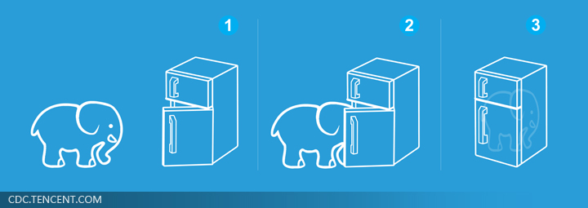

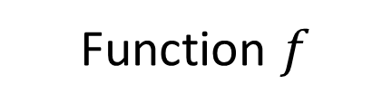
Machine Learning is Simple
Step 1: define a set of function
Step 2: goodness of function
Step 3: pick the best function
Meta
Function $f$
Learning algorithm $F$
就好像把大象放進冰箱 ……

Slide 6






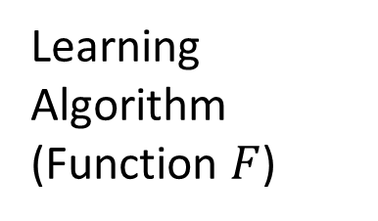
Meta Learning
Different decisions in the red boxes lead to different algorithms.
What happens in the red boxes is decided by humans until now.
Define a set of learning algorithm
$$\hat{θ}$$
Network
Structure
Update
Update
$$θ^{0}$$
$$θ^{1}$$
$$θ^{2}$$
Init
$$g$$
$$g$$
Learning Algorithm
(Function $F$)
Compute Gradient
Compute Gradient
Training
Data
Training
Data
(limit to gradient descent based approach)

Slide 7
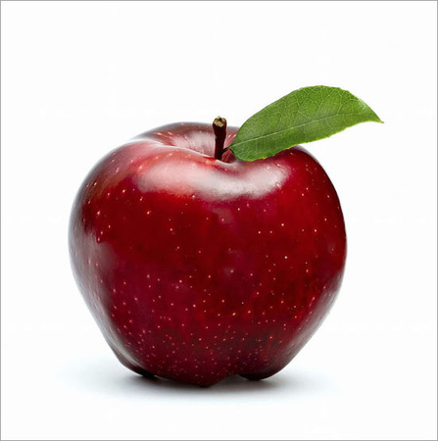
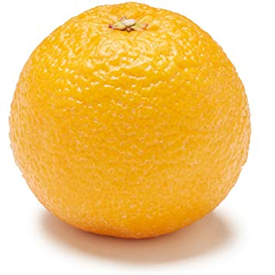
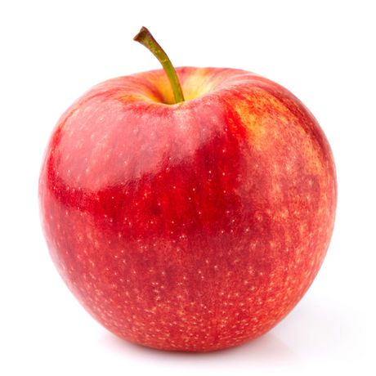
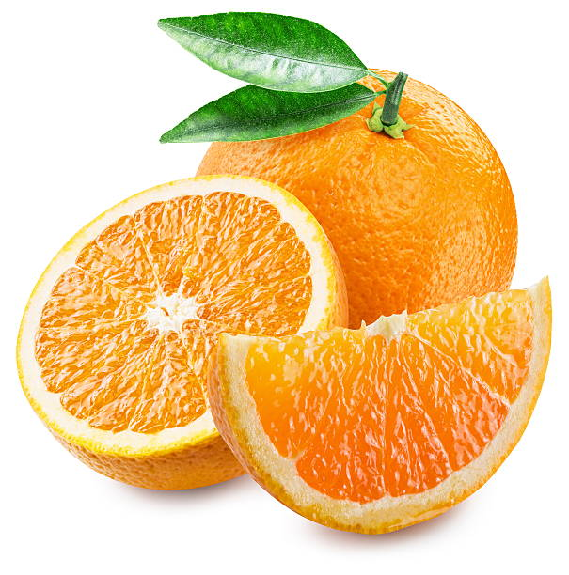








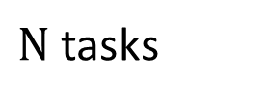
Meta Learning
$N$ tasks
$$L\left(F\right)=\sum_{n=1}^{N}{l^{n} }$$
Testing loss for task n after training
Defining the goodness of a function $F$
Train
Train
cat
dog
apple
orange
Task 1
Task 2
Learning
Algorithm $F$
Learning
Algorithm $F$
Test
Test
$$f^{1}$$
$$f^{2}$$
cat
dog
apple
orange
$$l^{1}$$
$$l^{2}$$

Slide 8
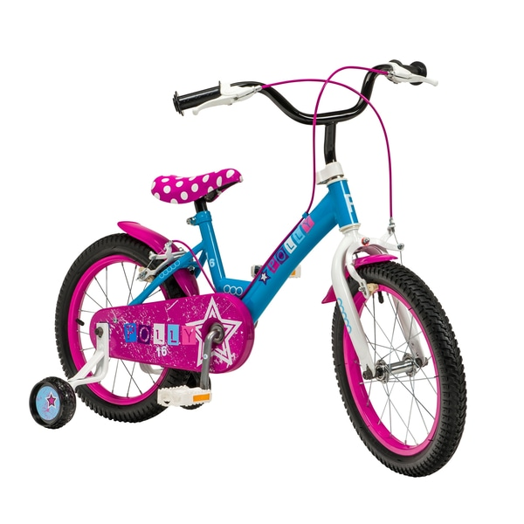
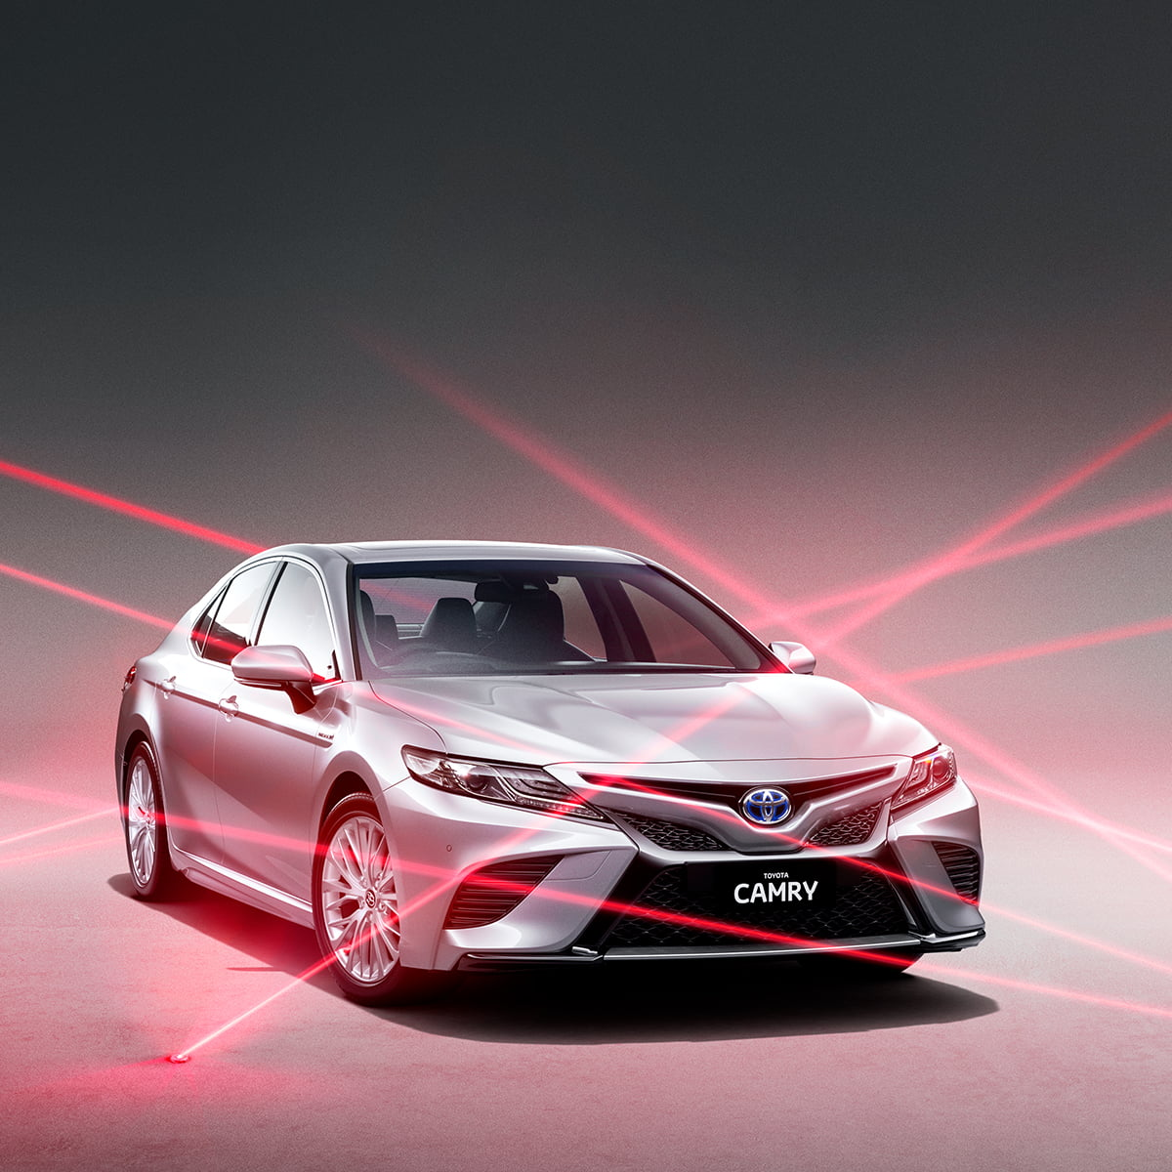
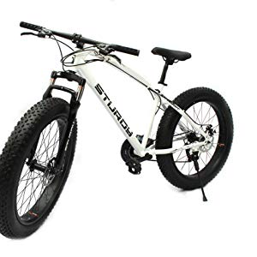

Meta Learning
Machine Learning
Widely considered in
few-shot learning
cat
dog
cat
dog
Train
Test
Support set
Query set
Task 1
Train
Test
Training
Tasks
cat
dog
cat
dog
Task 2
Train
Test
apple
orange
apple
orange
Sometimes you need validation tasks
Testing Tasks
Train
Test
bike
car
bike
car
Notes:
Widely considered in
few-shot learning

Slide 9






Meta Learning
Defining the goodness of a function $F$
Find the best function $F^{∗}$
$$L\left(F\right)=\sum_{n=1}^{N}{l^{n} }$$
Train
Testing: Task New
bike
car
Learning
Algorithm $F^{∗}$
Test
$$F^{∗}=arg\min_{F}{L\left(F\right)}$$
$$f^{∗}$$
bike
car
$$l$$
Notes:
Step1

Slide 10
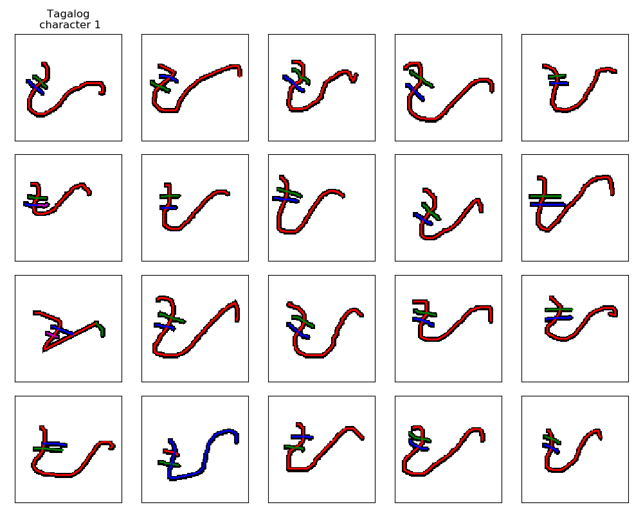
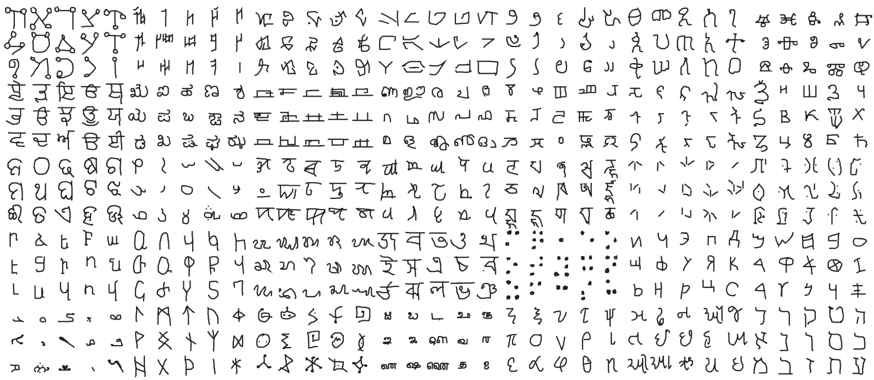
Omniglot
https://github.com/brendenlake/omniglot
1623 characters
Each has 20 examples
Notes:
https://github.com/google-research/meta-dataset
https://arxiv.org/abs/1902.03477
https://science.sciencemag.org/content/350/6266/1332

Slide 11
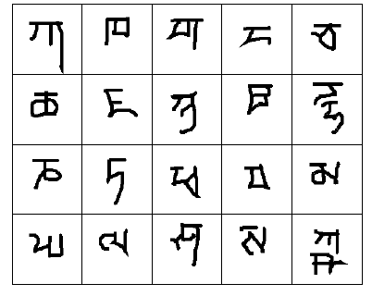
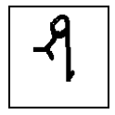
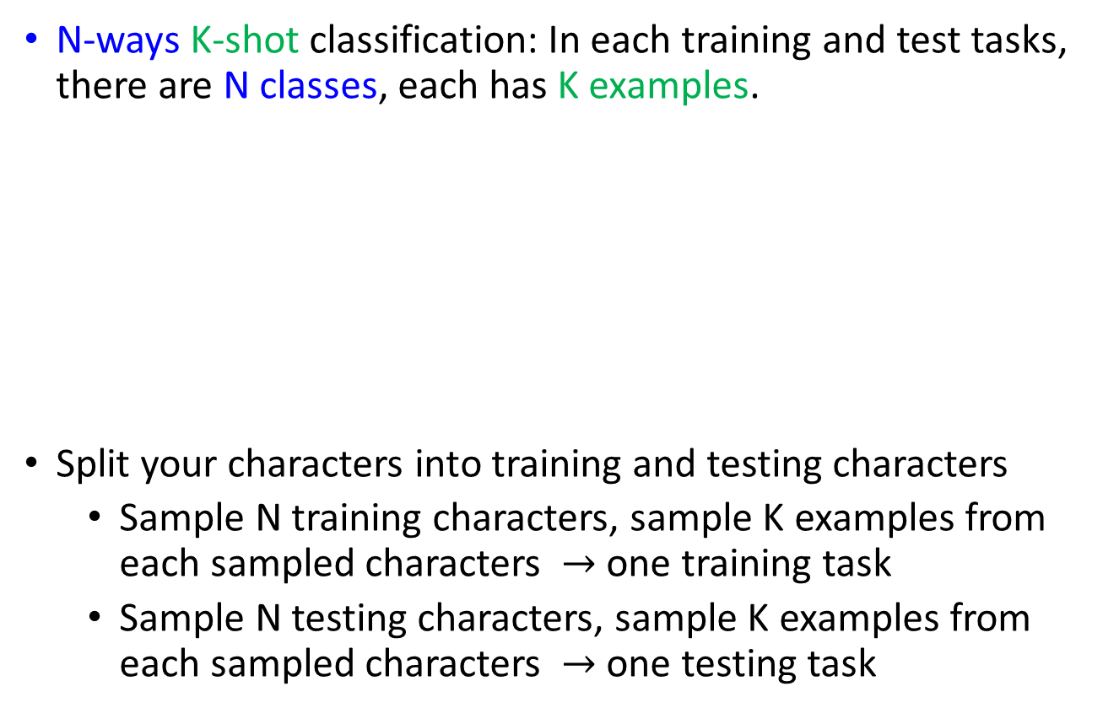
Omniglot – Few-shot Classification
Demo of Reptile:
https://openai.com/blog/reptile/
N-ways K-shot classification: In each training and test tasks, there are N classes, each has K examples.
Split your characters into training and testing characters
Sample N training characters, sample K examples from each sampled characters $→$ one training task
Sample N testing characters, sample K examples from each sampled characters $→$ one testing task
20 ways
1 shot
Testing set
(Query set)
Each character represents a class
Training set
(Support set)

Slide 12
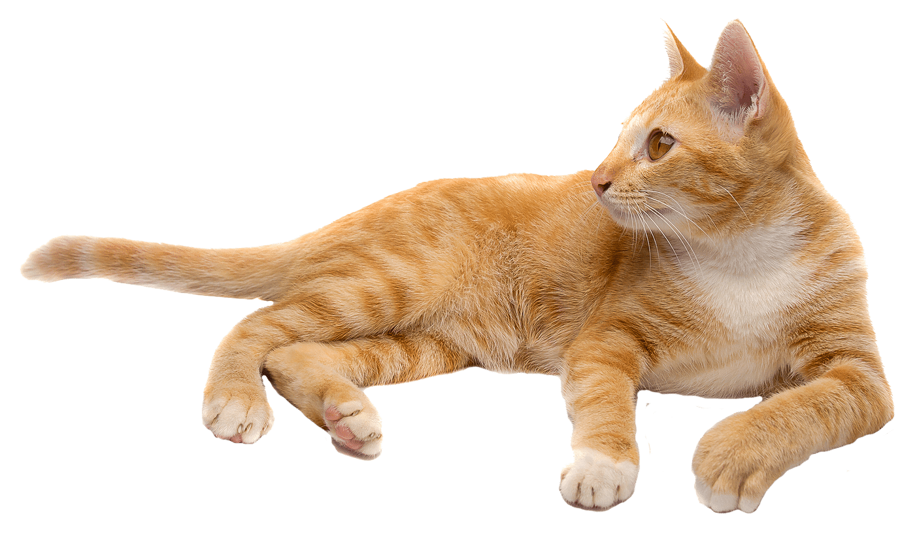
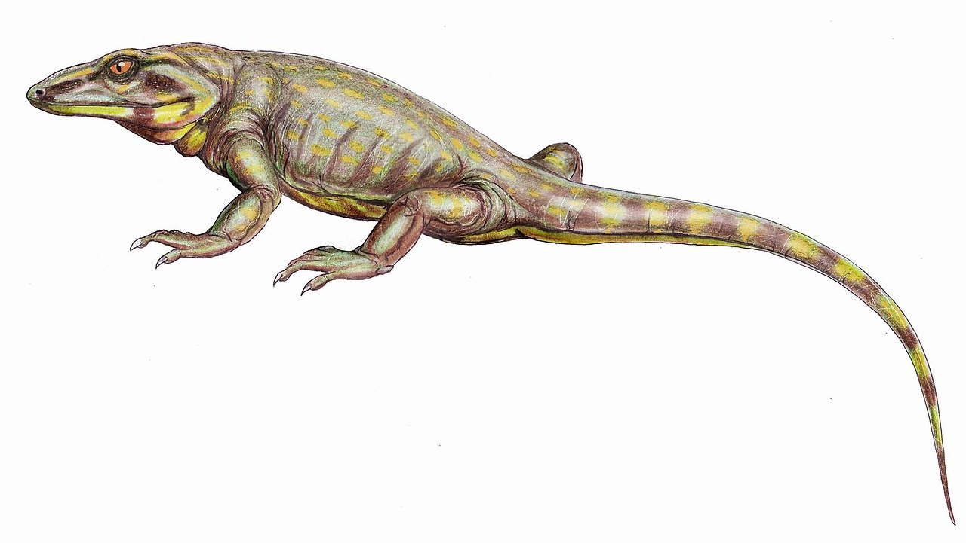
Techniques Today
MAML
Chelsea Finn, Pieter Abbeel, and Sergey Levine, “Model-Agnostic Meta-Learning for Fast Adaptation of Deep Networks”, ICML, 2017
Reptile
Alex Nichol, Joshua Achiam, John Schulman, On First-Order Meta-Learning Algorithms, arXiv, 2018
Notes:
[1] Santoro, Adam, Bartunov, Sergey, Botvinick, Matthew, Wierstra, Daan, and Lillicrap, Timothy. Meta-learning with memory-augmented neural networks. In Proceedings of The 33rd International Conference on Machine Learning, pp. 1842–1850, 2016.
[2] Munkhdalai T, Yu H. Meta Networks. arXiv preprint arXiv:1703.00837, 2017.
[3] Learning to learn by gradient descent by gradient descent.
[1] Ravi, Sachin and Larochelle, Hugo. Optimization as a model for few-shot learning. In International Conference on Learning Representations (ICLR), 2017.
Meta-Learning for Low-Resource Neural Machine Translation (read)

Slide 13
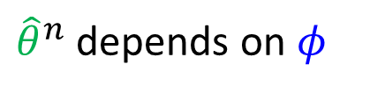

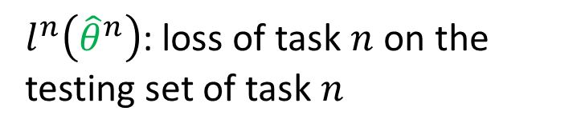
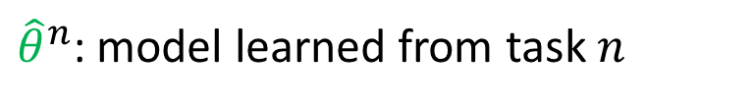


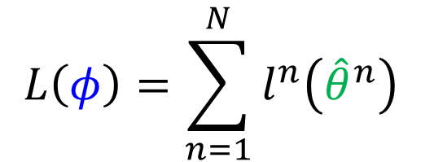

MAML
${\hat{θ}}^{n}$: model learned from task $n$
Loss Function:
${\hat{θ}}^{n}$ depends on $φ$
$$L\left(φ\right)=\sum_{n=1}^{N}{l^{n}\left({\hat{θ}}^{n}\right) }$$
$l^{n}\left({\hat{θ}}^{n}\right)$: loss of task $n$ on the testing set of task $n$
$$\hat{θ}$$
Network
Structure
$$φ$$
Update
Update
$$θ^{0}$$
$$θ^{1}$$
$$θ^{2}$$
Init
$$∇θ$$
$$∇θ$$
Learning Algorithm
(Function $F$)
Compute Gradient
Compute Gradient
Only focus on initialization parameter
Training
Data
Training
Data
$$φ$$

Slide 14
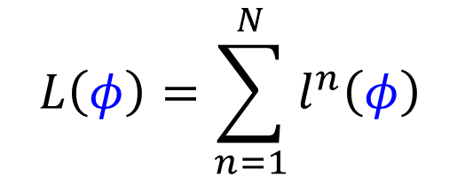
MAML
${\hat{θ}}^{n}$: model learned from task $n$
Loss Function:
${\hat{θ}}^{n}$ depends on $φ$
$$L\left(φ\right)=\sum_{n=1}^{N}{l^{n}\left({\hat{θ}}^{n}\right) }$$
$l^{n}\left({\hat{θ}}^{n}\right)$: loss of task $n$ on the testing set of task $n$
How to minimize $L\left(φ\right)$?
Gradient Descent
$$φ←φ−η∇_{φ}L\left(φ\right)$$
Model Pre-training
Loss Function:
$$L\left(φ\right)=\sum_{n=1}^{N}{l^{n}\left(φ\right) }$$
Widely used in transfer learning
Notes:
PhD ….？？？？？
The difference here is that the initial network was trained with the explicit purpose of being easily generalizable, whereas transfer learning just “accidentally” happens to work, and thus might not work optimally.

Slide 15
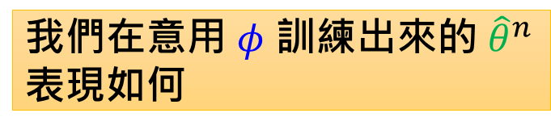

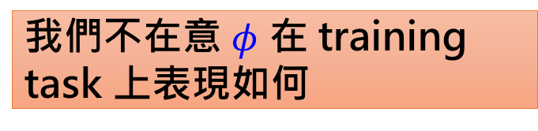
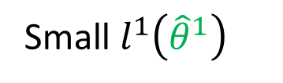
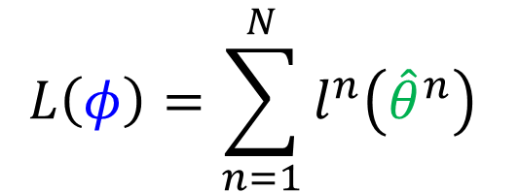


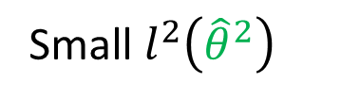


MAML
我們不在意 $φ$ 在 training task 上表現如何
$$L\left(φ\right)=\sum_{n=1}^{N}{l^{n}\left({\hat{θ}}^{n}\right) }$$
我們在意用 $φ$ 訓練出來的 ${\hat{θ}}^{n}$表現如何
$l^{1}$ (Loss of task 1)
$l^{2}$ (Loss of task 2)
Small $l^{2}\left({\hat{θ}}^{2}\right)$
$${\hat{θ}}^{1}$$
$$φ$$
$${\hat{θ}}^{2}$$
Model Parameter
Small $l^{1}\left({\hat{θ}}^{1}\right)$

Slide 16


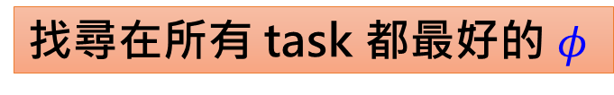
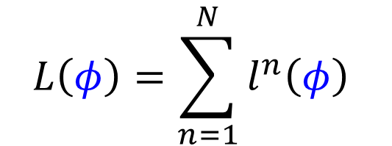

Model Pre-training
找尋在所有 task 都最好的 $φ$
$$L\left(φ\right)=\sum_{n=1}^{N}{l^{n}\left(φ\right) }$$
並不保證拿 $φ$ 去訓練以後會得到好的 ${\hat{θ}}^{n}$
$l^{1}$ (Loss of task 1)
$l^{2}$ (Loss of task 2)
$$l^{2}\left({\hat{θ}}^{2}\right)$$
$$φ$$
Model Parameter

Slide 17


MAML
${\hat{θ}}^{n}$: model learned from task $n$
Loss Function:
${\hat{θ}}^{n}$ depends on $φ$
$$L\left(φ\right)=\sum_{n=1}^{N}{l^{n}\left({\hat{θ}}^{n}\right) }$$
$l^{n}\left({\hat{θ}}^{n}\right)$: loss of task $n$ on the testing set of task $n$
How to minimize $L\left(φ\right)$?
Gradient Descent
$$φ←φ−η∇_{φ}L\left(φ\right)$$
Find $φ$ achieving good performance after training
潛力
Model Pre-training
Loss Function:
$$L\left(φ\right)=\sum_{n=1}^{N}{l^{n}\left(φ\right) }$$
Widely used in transfer learning
Find $φ$ achieving good performance
現在表現如何
Notes:
PhD ….？？？？？
The difference here is that the initial network was trained with the explicit purpose of being easily generalizable, whereas transfer learning just “accidentally” happens to work, and thus might not work optimally.

Slide 18





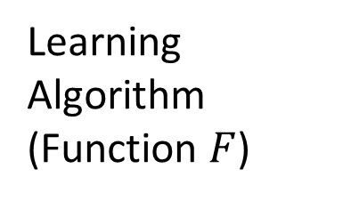



MAML
Fast … Fast … Fast …
Good to truly train a model with one step. ☺
When using the algorithm, still update many times.
Few-shot learning has limited data.
$$\hat{θ}$$
$$L\left(φ\right)=\sum_{n=1}^{N}{l^{n}\left({\hat{θ}}^{n}\right) }$$
Network
Structure
$$φ$$
Update
$$θ^{0}$$
Init
$$g$$
Learning Algorithm
(Function $F$)
$$φ←φ−η∇_{φ}L\left(φ\right)$$
Compute Gradient
Considering one-step training:
Only focus on initialization parameter
Training
Data
$$\hat{θ}＝φ－ε∇_{φ}l\left(φ\right)$$
$$φ$$

Slide 19
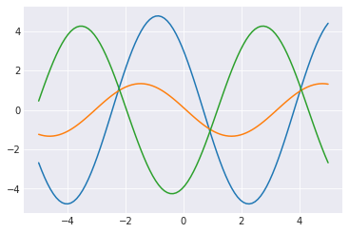

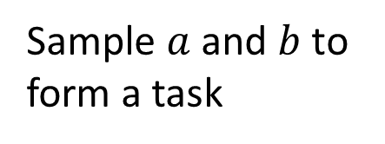
Toy Example
Source of images https://towardsdatascience.com/paper-repro-deep-metalearning-using-maml-and-reptile-fd1df1cc81b0
Each task:
Given a target sine function $y=a sin\left(x+b\right)$
Sample K points from the target function
Use the samples to estimate the target function
Sample $a$ and $b$ to form a task
Notes:
In this K-shot problem, each task consists in learning a modified sine function. Specifically, for each task, the underlying function will be of the form y = a sin(x + b), with both a and b chosen randomly, and the goal of our neural network is to learn to find y given x based on only 10 (x, y) pairs.

Slide 20
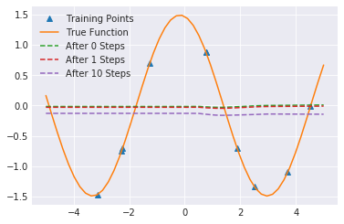

Toy Example
Model Pre-training
Source of images https://towardsdatascience.com/paper-repro-deep-metalearning-using-maml-and-reptile-fd1df1cc81b0
MAML

Slide 21


Omniglot & Mini-ImageNet
https://arxiv.org/abs/1703.03400

Slide 22
Warning of Math

Slide 23













$$φ←φ−η∇_{φ}L\left(φ\right)$$
$$∇_{φ}L\left(φ\right)=∇_{φ}\sum_{n=1}^{N}{l^{n}\left({\hat{θ}}^{n}\right) }$$
$$=\sum_{n=1}^{N}{∇_{φ}l^{n}\left({\hat{θ}}^{n}\right) }$$
$$L\left(φ\right)=\sum_{n=1}^{N}{l^{n}\left({\hat{θ}}^{n}\right) }$$
$$\frac{∂l\left(\hat{θ}\right)}{∂φ_{i}}=\sum_{j}{\frac{∂l\left(\hat{θ}\right)}{∂{\hat{θ}}_{j}}\frac{∂{\hat{θ}}_{j}}{∂φ_{i}}}$$
$$\hat{θ}＝φ－ε∇_{φ}l\left(φ\right)$$
$${\hat{θ}}_{1}$$
$$=\left[\begin{aligned}{∂l\left(\hat{θ}\right)}/{∂φ_{1}} \\ {∂l\left(\hat{θ}\right)}/{∂φ_{2}} \\ ⋮ \\ {∂l\left(\hat{θ}\right)}/{∂φ_{i}} \\ ⋮\end{aligned}\right]$$
$${\hat{θ}}_{2}$$
$$φ_{i}$$
$$l\left(\hat{θ}\right)$$
$$∇_{φ}l\left(\hat{θ}\right)$$
…
$${\hat{θ}}_{j}$$
…

Slide 24








$$φ←φ−η∇_{φ}L\left(φ\right)$$
$$∇_{φ}L\left(φ\right)=∇_{φ}\sum_{n=1}^{N}{l^{n}\left({\hat{θ}}^{n}\right) }$$
$$=\sum_{n=1}^{N}{∇_{φ}l^{n}\left({\hat{θ}}^{n}\right) }$$
$$L\left(φ\right)=\sum_{n=1}^{N}{l^{n}\left({\hat{θ}}^{n}\right) }$$
$$≈\frac{∂l\left(\hat{θ}\right)}{∂{\hat{θ}}_{i}}$$
$$\frac{∂l\left(\hat{θ}\right)}{∂φ_{i}}=\sum_{j}{\frac{∂l\left(\hat{θ}\right)}{∂{\hat{θ}}_{j}}\frac{∂{\hat{θ}}_{j}}{∂φ_{i}}}$$
$$\hat{θ}＝φ－ε∇_{φ}l\left(φ\right)$$
$${\hat{θ}}_{j}＝φ_{j}－ε\frac{∂l\left(φ\right)}{∂φ_{j}}$$
$$i≠j:$$
$$\frac{∂{\hat{θ}}_{j}}{∂φ_{i}}＝－ε\frac{∂l\left(φ\right)}{∂φ_{i}∂φ_{j}}$$
$$=\left[\begin{aligned}{∂l\left(\hat{θ}\right)}/{∂φ_{1}} \\ {∂l\left(\hat{θ}\right)}/{∂φ_{2}} \\ ⋮ \\ {∂l\left(\hat{θ}\right)}/{∂φ_{i}} \\ ⋮\end{aligned}\right]$$
$$≈0$$
$$i=j:$$
$$∇_{φ}l\left(\hat{θ}\right)$$
$$\frac{∂{\hat{θ}}_{j}}{∂φ_{i}}＝1－ε\frac{∂l\left(φ\right)}{∂φ_{i}∂φ_{j}}$$
$$≈1$$

Slide 25




$$φ←φ−η∇_{φ}L\left(φ\right)$$
$$∇_{φ}L\left(φ\right)=∇_{φ}\sum_{n=1}^{N}{l^{n}\left({\hat{θ}}^{n}\right) }$$
$$=\sum_{n=1}^{N}{∇_{φ}l^{n}\left({\hat{θ}}^{n}\right) }$$
$$L\left(φ\right)=\sum_{n=1}^{N}{l^{n}\left({\hat{θ}}^{n}\right) }$$
$${\hat{θ}}^{n}$$
$$≈\frac{∂l\left(\hat{θ}\right)}{∂{\hat{θ}}_{i}}$$
$$\frac{∂l\left(\hat{θ}\right)}{∂φ_{i}}=\sum_{j}{\frac{∂l\left(\hat{θ}\right)}{∂{\hat{θ}}_{j}}\frac{∂{\hat{θ}}_{j}}{∂φ_{i}}}$$
$$\hat{θ}＝φ－ε∇_{φ}l\left(φ\right)$$
$$=\left[\begin{aligned}{∂l\left(\hat{θ}\right)}/{∂φ_{1}} \\ {∂l\left(\hat{θ}\right)}/{∂φ_{2}} \\ ⋮ \\ {∂l\left(\hat{θ}\right)}/{∂φ_{i}} \\ ⋮\end{aligned}\right]$$
$$=\left[\begin{aligned}{∂l\left(\hat{θ}\right)}/{∂{\hat{θ}}_{1}} \\ {∂l\left(\hat{θ}\right)}/{∂{\hat{θ}}_{2}} \\ ⋮ \\ {∂l\left(\hat{θ}\right)}/{∂{\hat{θ}}_{i}} \\ ⋮\end{aligned}\right]$$
$$∇_{φ}l\left(\hat{θ}\right)$$
$$=∇_{\hat{θ}}l\left(\hat{θ}\right)$$

Slide 26
End of Warning

Slide 27










MAML – Real Implementation
Sample a training task m
$${\hat{θ}}^{m}$$
Model Pre-training
$$φ^{0}$$
$$φ^{1}$$
$${\hat{θ}}^{m}$$
$$φ^{1}$$
$${\hat{θ}}^{n}$$
$$φ^{2}$$
$${\hat{θ}}^{n}$$
Sample a training task n
$$φ^{0}$$
$$φ^{2}$$

Slide 28

Translation
18 training tasks: 18 different languages translating to English
2 validation tasks: 2 different languages translating to English
Ro = Romanian
Fi = Finnish
https://arxiv.org/abs/1808.08437

Slide 29
Techniques Today
MAML
Chelsea Finn, Pieter Abbeel, and Sergey Levine, “Model-Agnostic Meta-Learning for Fast Adaptation of Deep Networks”, ICML, 2017
Reptile
Alex Nichol, Joshua Achiam, John Schulman, On First-Order Meta-Learning Algorithms, arXiv, 2018
https://openai.com/blog/reptile/
Notes:
[1] Santoro, Adam, Bartunov, Sergey, Botvinick, Matthew, Wierstra, Daan, and Lillicrap, Timothy. Meta-learning with memory-augmented neural networks. In Proceedings of The 33rd International Conference on Machine Learning, pp. 1842–1850, 2016.
[2] Munkhdalai T, Yu H. Meta Networks. arXiv preprint arXiv:1703.00837, 2017.
[3] Learning to learn by gradient descent by gradient descent.
[1] Ravi, Sachin and Larochelle, Hugo. Optimization as a model for few-shot learning. In International Conference on Learning Representations (ICLR), 2017.
Meta-Learning for Low-Resource Neural Machine Translation (read)

Slide 30





Reptile
Sample a training task m
$$φ^{0}$$
$$φ^{1}$$
$${\hat{θ}}^{m}$$
$$φ^{2}$$
Sample a training task n
$${\hat{θ}}^{n}$$
(this sentence is removed in the updated version)

Slide 31







Reptile
Pre-train: $g_{1}$
$$g_{1}$$
$$g_{2}$$
$$φ$$
Reptile: $g_{1}+g_{2}$
MAML: $g_{2}$
(simplified)
Pre-train

Slide 32

More …
Video: https://www.youtube.com/watch?v=c10nxBcSH14
Training a network (by RL) to determine …
Architecture
& Activation
How to update
$$\hat{θ}$$
Network
Structure
$$φ$$
Update
Update
$$θ^{0}$$
$$θ^{1}$$
$$θ^{2}$$
Init
$$∇θ$$
$$∇θ$$
Learning Algorithm
(Function $F$)
Compute Gradient
Compute Gradient
MAML, Reptile
Training
Data
Training
Data

Slide 33


Turtles all the way down …… ?
We learn the initialization parameter $φ$ by gradient descent
What is the initialization parameter $φ^{0}$ for initialization parameter $φ$?
Learn
Learn to learn
Learn to learn to learn
Notes:
無限的盡頭

Slide 34



Crazy Idea?
下回分解 ☺
How about learning algorithm beyond gradient descent?
cat
Learning Algorithm
(Function $F$)
$$\hat{θ}$$
Just a network
Design network architecture
$=$ Design training algorithm?
Learn an even bigger function
cat
dog
Training Data
Testing Data

